Slide 1

IBM Capstone Project
Opening an Indian restaurant in Amsterdam, Netherlands
August 2019

Slide 2
Introduction
Amsterdam is the capital of Netherlands and is one of the most popular destinations of Europe, receiving more than 4.63 million tourists annually. From its earliest days, Amsterdam has also been a bustling hub of commerce that welcomed other cultures with open arms. It is also popular for its night life and parties. For tourists coming from different parts of the world, shopping and food are one of the key elements of visiting a city, especially for a place like Amsterdam. They would be interested in buying something local (for memory) or would like to dine in a good restaurant for trying out different cuisines. I have lived in Almere for almost a year, which is closer to Amsterdam and have often explored the city over the weekends and have found that are not many authentic Indian restaurants. Most of them are run by people who are not Indians, and hence it lacks the Indian touch and flavour. Indian cuisines have so much variety that anybody would relish the flavours. It includes North Indian, Mughlai, Indo-Chinese etc. Because India has so many states and every state has their own regional cuisines it is very difficult to name everyone here. Opening a restaurant in any popular area requires a meticulous research and is more complicated than it seems such as finding good authentic Indian cooks and what kind of restaurants are operational in that area. Will a new Indian restaurant be a success or failure depends on lot many factors like budget, labour, rent, accessibility to that area, how popular that are is? etc.

Slide 3
Business Problem
This capstone project will answer the business problem: Where would someone open an authentic Indian restaurant in the city of Amsterdam? We will select best neighbourhoods in the city of Amsterdam and using data science techniques such as clustering will answer the question.

Slide 4
Target Group
This project would be particularly helpful to people who would want to diversify their businesses or get into the food industry. Since Indian cuisines are extremely popular in the world because of its rich variety and flavours, it would be worth the risk as Amsterdam is bustling with tourists throughout the year. As per a recent report issued by Euromonitor, the restaurant business sector in Netherlands was one of the prolific economic segments in 2015 and 2016. The two main factors contributing to the development of the food sector were: the steady economic growth of Netherlands and the higher consumer confidence.

Slide 5
Data
List of neighbourhoods in Amsterdam
Latitude and Longitude of those neighbourhoods for plotting the map and getting the venue data.
Venue data especially restaurant details and use it for clustering the neighbourhoods.

Slide 6
Methodology
https://en.wikipedia.org/wiki/Category:Neighbourhoods_of_Amsterdam: Web Scraping for getting the neighbourhoods of Amsterdam City.
Python Geocoder package for getting the coordinates of neighbourhoods.
Foursquare API for getting the venue details of each neighbourhood.
k-Means for clustering the neighbourhoods.

Slide 7
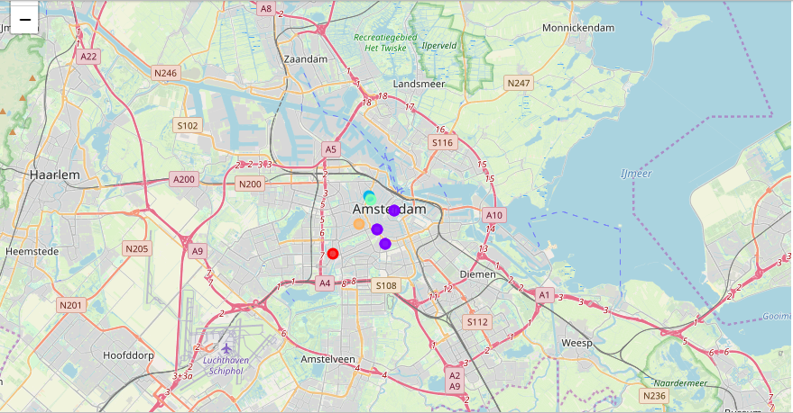
K-Means Clustering

Slide 8
Discussion
Most of the Indian restaurants are located in cluster 1, whereas there are no Indian restaurants in cluster 0,2,3,4 in the top 10 venues in top 10 neighbourhoods. In my first level analysis, where I had said if someone has to open an Indian restaurant they can open in the following areas: Amsterdam Oud-West, Frederik Hendrikbuurt or Hoofddorppleinbuurt because there are either 0 or 1 Indian restaurant in each of these neighbourhoods (check above, no k-means clustering used). You can even add Jordaan to it but I won’t go with because it already has 2 Indian restaurants. I would rather go with Amsterdam Oud-West as it has lowest k-means amongst all the clusters and is closer to Amsterdam train station.

Slide 9
Conclusion
I had specifically chosen Indian restaurants because of the crowd it can pull. Of-course there are other cuisines one can choose for analysis and decision making. Nevertheless, we can also include rating of each Indian restaurant to add more value to the analysis and may be if ratings are low, someone can actually open a good Indian restaurant. I have also not considered other venue categories such as Shopping Mall, Grocery store, Hotels, Museums etc which can also help in determining whether a restaurant can be open in that neighbourhood.

